Slide 1
Discovering Business Intelligence as a Decision Support System
By: Trevor Hofmann

Slide 2
About Me
Trevor Hofmann
Systems Administrator for Amarillo Independent School District
Live in Amarillo
Master of Science in Computer Information Systems
Undergraduate in August 2017

Slide 3
Definition
Business Intelligence (BI)
Decision Support System
A broad category of applications and technologies for gathering, storing, analyzing, and providing access to data to help enterprise users make better business decisions.
A computer program application that analyzes business data and presents it so that users can make business decisions more easily.

Slide 4
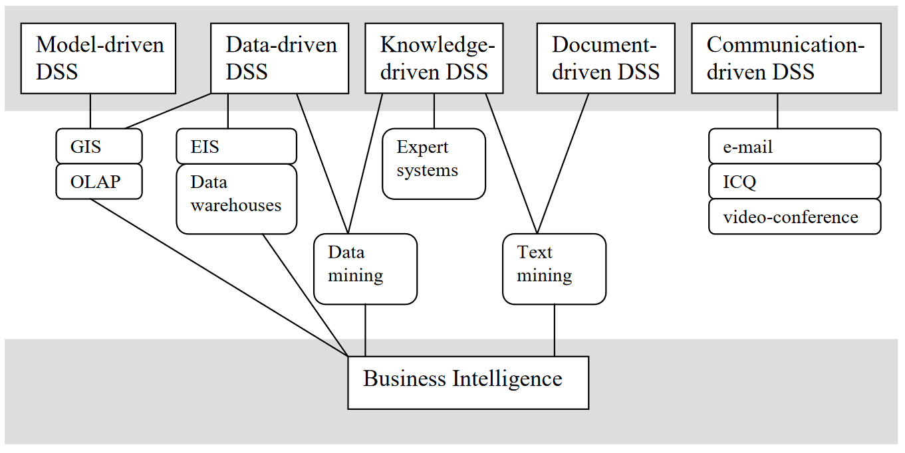
Similarities and Differences

Slide 5
Identify and Develop a Case
Amarillo Independent School District
Student data
Computer Activity
Cameras

